Slide 1

Digital Data Transmission
Error Detection System
,ECE, KLH,2026-27
Presented By:
Geethika -2620040144
Raghuvansh -2620040182
Anvesh -2620040181
Charan -2620040143

Slide 2
INTRODUCTION :
The project focuses on detecting errors during digital data transmission.
It uses Parity Check and CRC techniques.
The system can be studied through hardware and software simulation.
Explores practical applications of these error-detection algorithms in foundational network hardware, such as routers, gateways, and NICs.

Slide 3
Channel Noise & Bit Errors :
Noise can affect digital data while it is being transmitted.
A bit may change from 0 to 1 or 1 to 0.
Two important types of errors are:
  → Single-bit error
  → Burst error
Single-Bit Errors :
Burst Errors :
1. Occurs when only one bit in a data packet is inverted (0 to 1 or 1 to 0) during transmission.
1. Occurs when two or more consecutive bits are corrupted due to impulse noise spikes.
2. Typically caused by short thermal fluctuations or mild background noise. Simple to catch using basic parity bits.
2. Presents a greater threat to data integrity, necessitating robust polynomial techniques like CRC to ensure reliable recovery.

Slide 4
Main Objective:
Detect single-bit and burst errors in transmitted data.
Add extra redundancy bits to help identify errors.
Use CRC to provide reliable detection of transmission errors.
Simulate noise and bit changes in the communication channel.
Verify the received data at the receiver and determine whether it contains errors.
System Execution Flow :
The transmission framework comprises three core stages:
1. Transmitter: Calculates redundancy bits from payload data.
2. Channel: Simulates line noise and bit-flip conditions.
3. Receiver: Verifies zero-remainder flags to validate data

Slide 5
Error Detection Techniques Are :
Parity Check:
The simplest method. An extra parity bit is added to the data.
- Even parity: number of 1s must be even.
- Odd parity: number of 1s must be odd.
- Simple and inexpensive.
- Mainly detects single-bit errors.
Checksum:
The data is divided into smaller sections, and mathematical calculations are performed to generate a checksum.
The checksum is sent along with the data. The receiver calculates it again and compares the values
- Common in networking.
Can detect many transmission errors.
CRC (Cyclic Redundancy Check):
CRC uses binary polynomial division to calculate a remainder. The remainder is attached to the original data. At the receiver, the same calculation is performed.
- Very reliable.
- Detects burst errors effectively.
- Widely used in networks, storage devices, and communication systems.

Slide 6
Proposed System:
→The proposed system is designed to detect errors in digital data during transmission.The system takes binary data from the sender and adds an error-detection code such as parity, checksum, or CRC. The data is then transmitted through a simulated communication channel. At the receiver, the data is checked to determine whether an error has occurred.
Key features:-
Detects corrupted digital data.
Simulates errors during transmission.
- Compares transmitted and received data.
- Displays “No Error” or “Error Detected.”
- Can be tested without requiring physical hardware.
Compared with simple error checking methods, the proposed system can use CRC for more reliable error detection, particularly for burst errors.

Slide 7
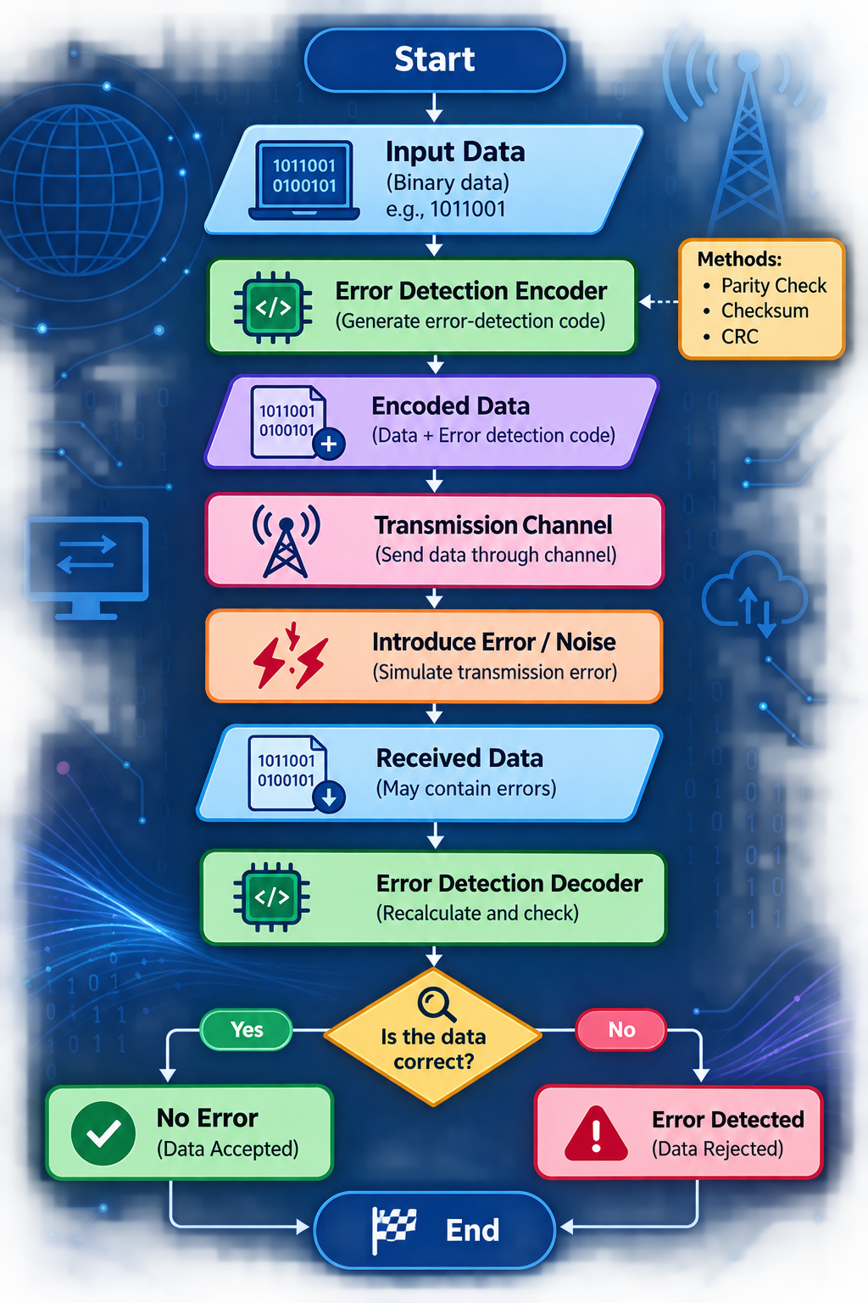

Explanation:-
Input Data: Binary data such as 1011001 is entered.
ENCODER: Generates additional error-detection information.
Transmission Channel: Represents the path through which data travels.
Error Generator: Changes one or more bits to simulate transmission errors.
DECODER: Checks the received data.
Output: Indicates whether the received data is correct or corrupted.

Slide 8
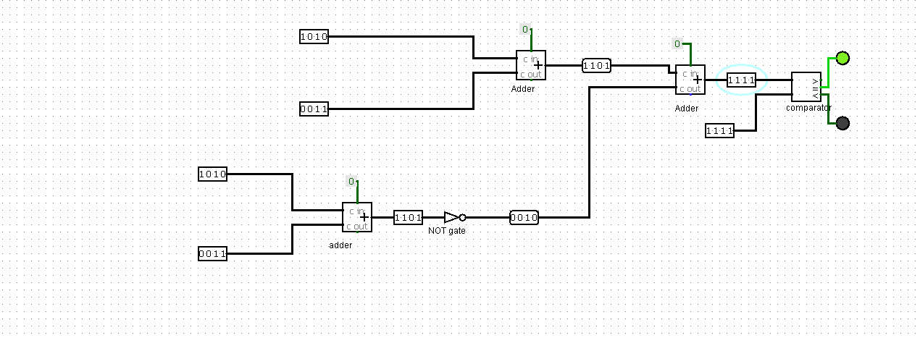
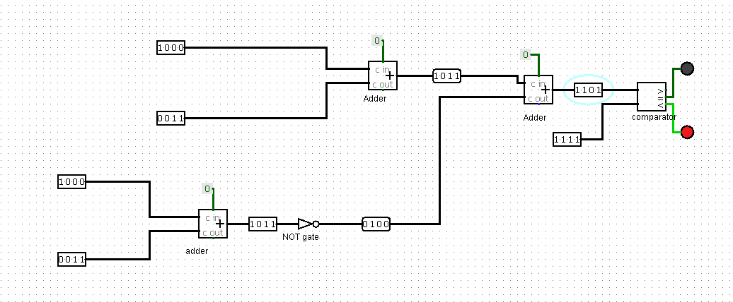

Working Principle :
Input Data – Take the original digital data.
Add Error Check Bits – Add extra bits using Parity or CRC.
Transmit Data – Send the data through the communication channel.
Noise May Cause Errors – Some bits may change during transmission.
Check at Receiver– The receiver checks the received data.
Detect Error – It determines whether the data has an error.
Final Result –if there is no error, then data is accepted;otherwise an error is detected.

Slide 9
Detection Reliability:
99.9%
High Accuracy Benchmark:
A standard CRC-8 configuration guarantees 100% detection for all single-bit errors, double-bit errors, odd-numbered bit errors, and burst errors up to 8 bits in length.
This provides ultra-reliable validation for noisy communication lines with minimal transmission overhead.
Result:
The Digital Data Transmission Error Detection System was successfully designed and simulated. The system detects errors that may occur during digital data transmission using an error-detection technique such as parity checking. The simulation shows that the receiver can identify whether the received data is correct or contains an error. Thus, the system helps improve the reliability and accuracy of digital communication.

Slide 10
CONCLUSION:
The project successfully demonstrates how errors in digital data transmission can be detected using an error-detection system.The system accepts binary data, adds error-detection information, simulates transmission, and checks the received data for errors. The simulation shows that the system can correctly identify both error-free and corrupted data. Therefore, the project achieves its main objective of improving the reliability and accuracy of digital communication.

